Slide 1
Statistics 367-1-4361 PyMC and Sampling
Opher Donchin

Slide 2
3A Review

Slide 3
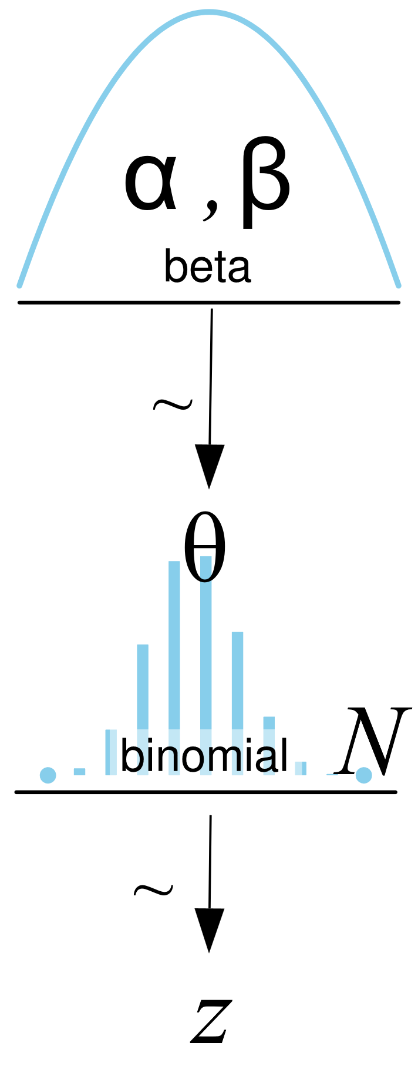
Models
Can write the model with equations or pictures

Slide 4
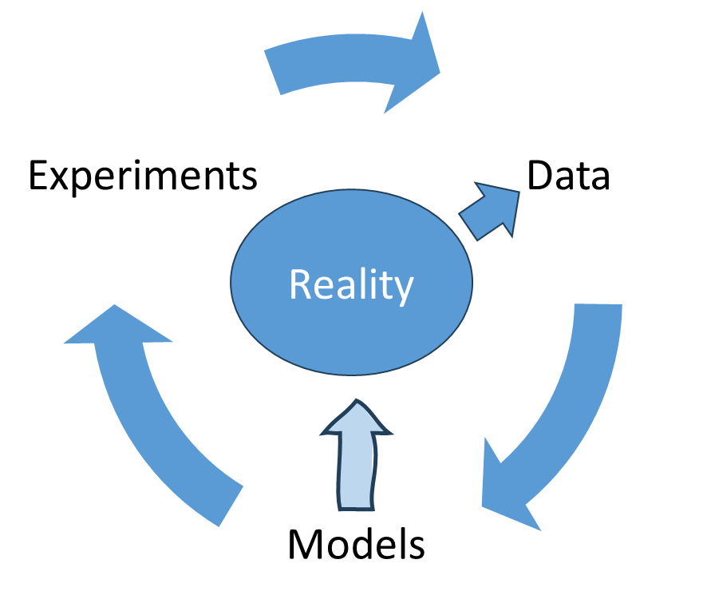
Baye’s rule updates models

Slide 5
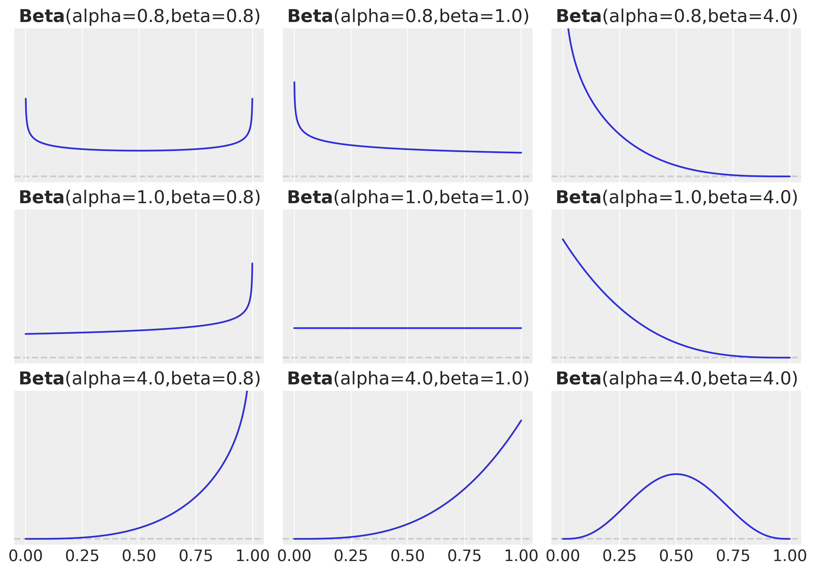
The beta prior for the binomial likelihood
Flexible
Conjugate
Interpretable

Slide 6
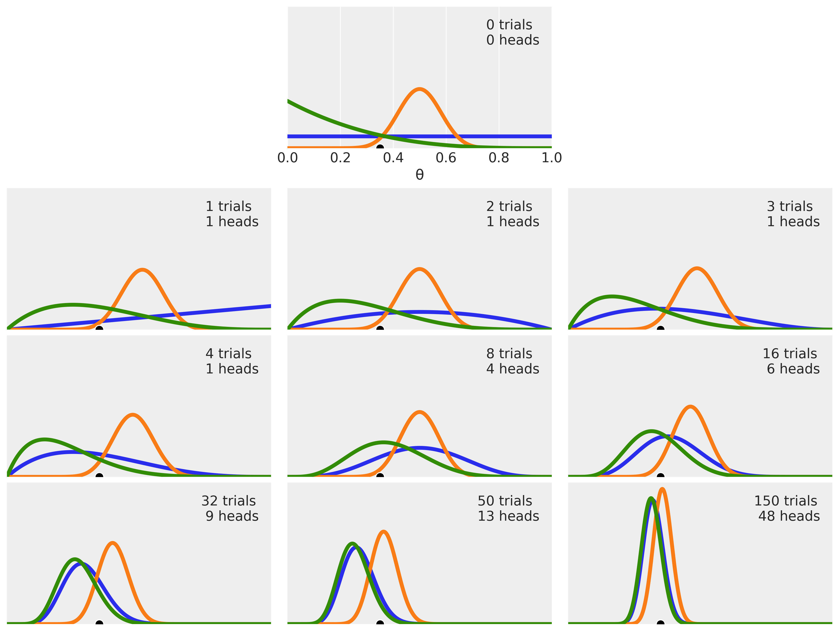
Prior and likelihood interact to produce posterior
More data
Sharper posterior
Overwhelms prior
Prior can still matter

Slide 7
3B A brief history of Bayesian Data Analysis

Slide 8
A history of Bayesian data analysis
The ancient world: 1930s-1950s
Rapid technological growth
Cultural flowering
Philosphical foundations
Purely analytical and mathematical approaches

Slide 9
A history of Bayesian data analysis
The ancient world: 1930s-1950s
The dark ages: 1950s-1980s
Bayesian data analysis becomes a rarely visited backwater
The frequentist empire expands
Technological developments
Widespread scientific and popular acceptance
Enormous worldwide influence
Early computers could do frequentist computations
But they couldn’t solve integrals to find the posterior distribution
Bayesian statistics is only tractable on very simple, toy examples

Slide 10
A history of Bayesian data analysis
The ancient world: 1930s-1950s
The dark ages: 1950s-1980s
The renaissance: early 1990s
New technologies fuel excitement
Technology creates a cascade of improvements
Monte-carlo Markov chain (MCMC) sampling promises good approximate solutions
Metropolis-Hastings and Gibbs sampling show the approach is feasible
Bayesian methods move from the mathematical to the computational world

Slide 11
A history of Bayesian data analysis
The ancient world: 1930s-1950s
The dark ages: 1950s-1980s
The renaissance: early 1990s
The industrial revolution: mid 1990s-early 2000s
Craftsmen and artisans are replaced with automated processes
The new machines are efficient but also clunky and dangerous
Automation leads to a sharp growth in efficiency and productivity
Early probabilistic programming languages PPLs like BUGS make MCMC available without programming the whole algorithm

Slide 12
A history of Bayesian data analysis
The ancient world: 1930s-1950s
The dark ages: 1950s-1980s
The renaissance: early 1990s
The industrial revolution: mid 1990s-early 2000s
The modern age: 2000s-2010s
Increasing use of probabilistic programming languages
Increasing acceptance of Baysian approaches
New generations of PPLs introduced

Slide 13
A history of Bayesian data analysis
The ancient world: 1930s-1950s
The dark ages: 1950s-1980s
The renaissance: early 1990s
The industrial revolution: mid 1990s-early 2000s
The modern age: 2000s-2010s
The information age: 2020s
Big data
Knowledge automatization
Increasing rates of change

Slide 14
3C Probablistic Programming Languages

Slide 15
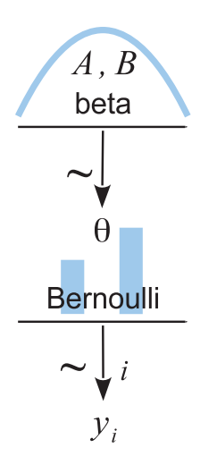
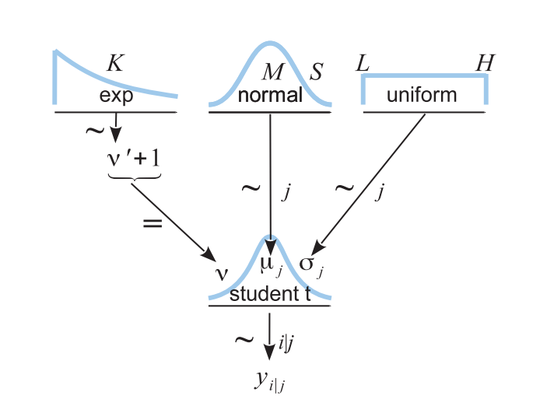
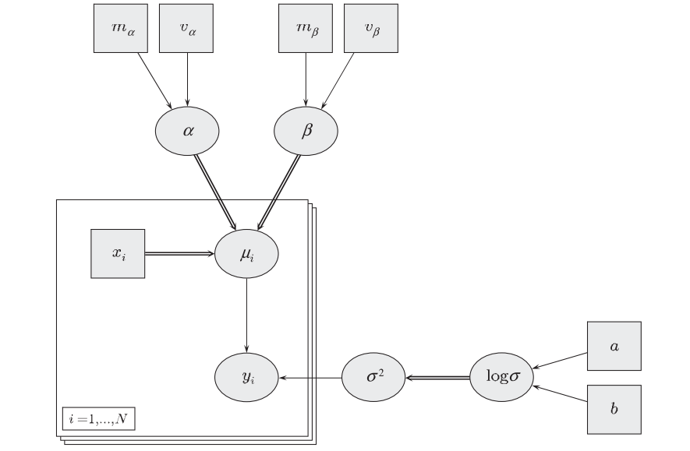
Bayesian networks / Graphical models
!

Slide 16

Translating a graphical model to a PPL
Equations
Graphical model
PyMC (a PPL)
with pm.Model() as our_first_model:
θ = pm.Beta('θ', alpha=1., beta=1.)
y = pm.Bernoulli('y', p=θ, observed=data)
idata = pm.sample(1000, random_seed=4591)
Three representations of the same idea

Slide 17
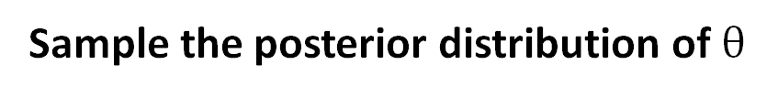
Sampling the posterior for fake data
Generate some fake data
trials = 4
theta_real = 0.35 # unknown value in a real experiment
data = pz.Binomial(n=1, p=theta_real).rvs(trials)
Create a Bayesian model
with pm.Model() as our_first_model:
θ = pm.Beta('θ', alpha=1., beta=1.)
y = pm.Bernoulli('y', p=θ, observed=data)
Sample the posterior distribution of $θ$
idata = pm.sample(1000, model=our_first _model, random_seed=4591)

Slide 18
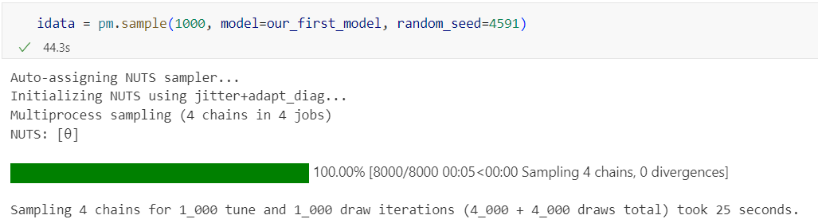
What happens when we call pm.sample()?
Pick a sampling algorithm
Initialize
Run multiple chains

Slide 19
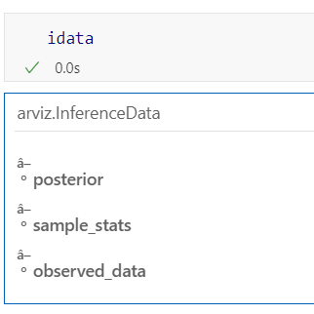
We get an inference data object
It has 3 groups
So far
Each group is an xarray Dataset

Slide 20
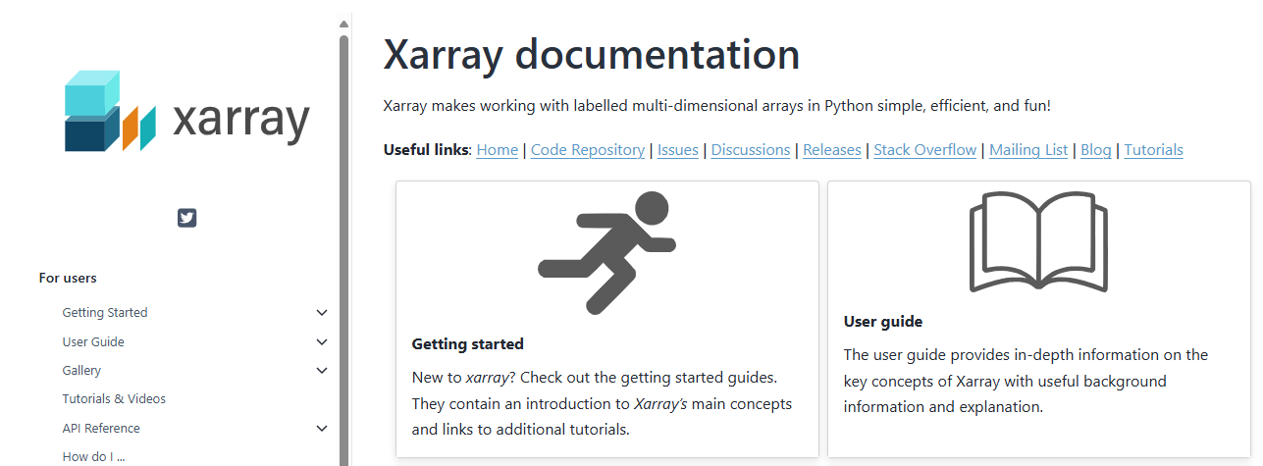
xarray
xarray Dataarrays extend Pandas dataframes to multiple dimensions
Each dimension and coordinate can have a name
Xarray datasets combine multiple Dataarrays
With shared dimensions

Slide 21
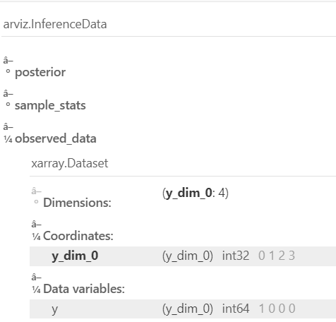
Observed_data is an xarray DataArray with the actual data
Four coin flips
1 head
3 tails

Slide 22
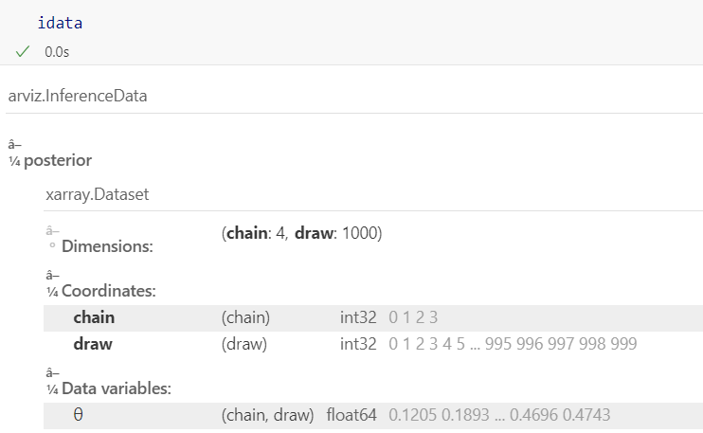
posterior has the samples
One variable: θ
Two dimensions: chain and draw
4,000 samples

Slide 23
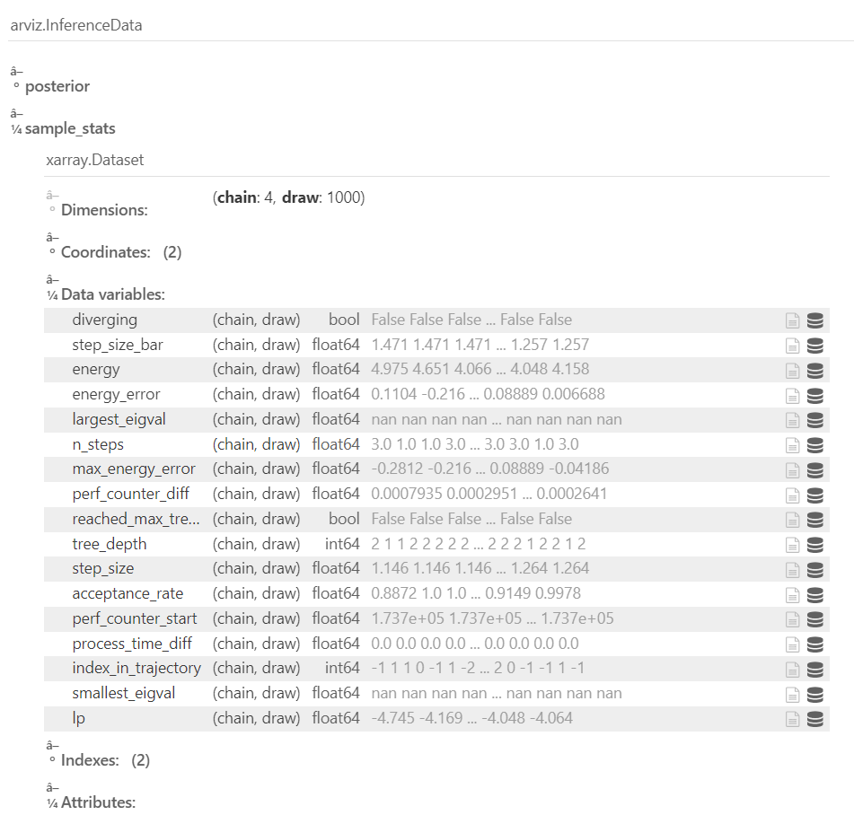
Sample stats contains data about sampling
Can be safely ignored for now

Slide 24
3D Sampling

Slide 25
Why sample?
Analytic solutions not always available?
Must choose a likelihood with a conjugate prior
Must have a conjugate prior that fits
Grid solution often too limited
Works great for 1 parameter
Becomes quickly untenable for more than 2 or 3 parameters
We’ll learn it on one parameter, just to make things simple

Slide 26
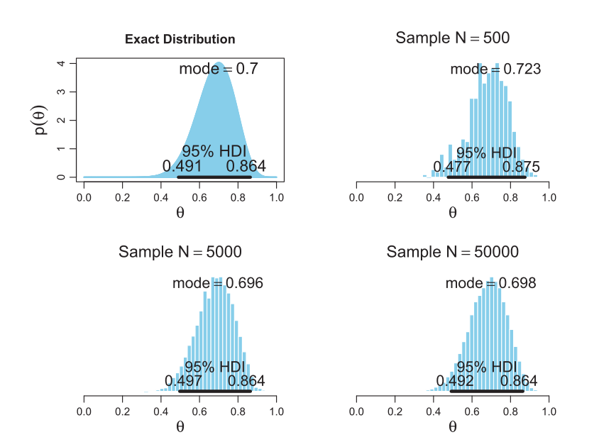
Sampling
We can sample in order to characterize a distribution

Slide 27
Sampling
We can sample in order to characterize a distribution
Larger samples give more accuracy

Slide 28
Sampling
We can sample in order to characterize a distribution
Larger samples give more accuracy
With a sample we can estimate parameters

Slide 29
Sampling and PPL
A PPL will have at least two parts:
Model building
Sampling
with pm.Model() as our_first_model:
θ = pm.Beta('θ', alpha=1., beta=1.)
y = pm.Bernoulli('y', p=θ, observed=data)
idata = pm.sample(1000, model=our_first _model, random_seed=4591)

Slide 30
3D PyMC

Slide 31
PyMC structure
Preliz
Specialized applications
PyMC
Distributions
Samplers
Models
Arviz
Utilities
Variational Bayes
Bambi

Slide 32
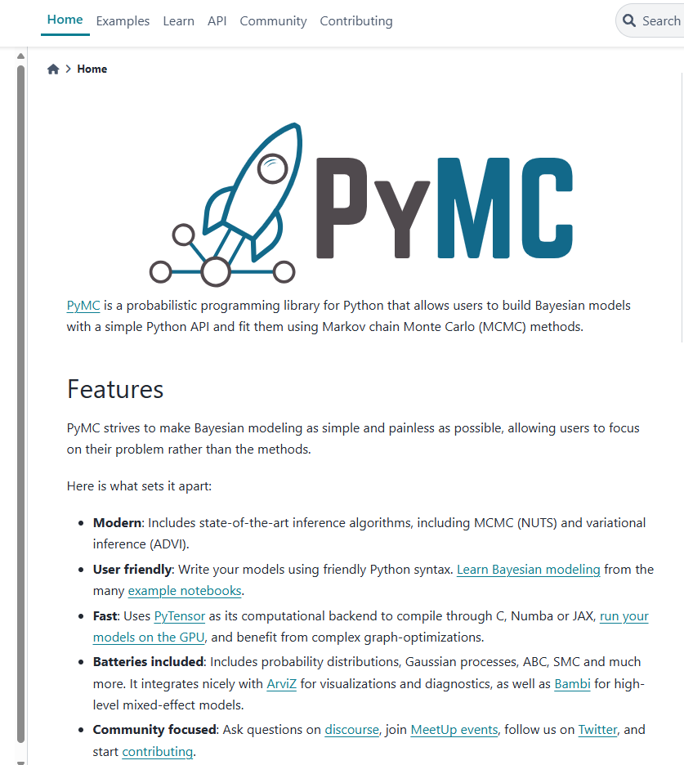
PyMC: a PPL for Python

Slide 33
Evolution of PPLs
Bugs (1989-1996)
Unix / Modula2
Sampling: 3 different samplers
WinBugs (1996-2008)
Windows / Component Pascal
Geological (2 dimensional) modelling
Doodle
OpenBugs (2004- )
Multi-platform
More flexible
Jags (2007- )
C++
Extensible
Stan (2012- )
C++
Compiles the sampler
Gradient-based methods
PyMC and many others
Python or R based

Slide 34
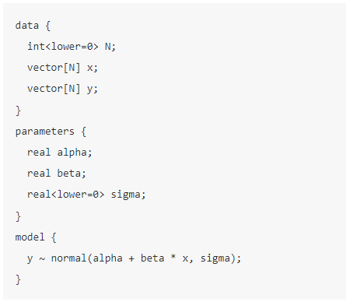
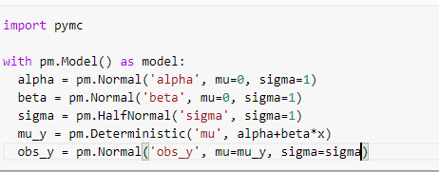
Two flavors of PPL
Separate language
Embedded in the code

Slide 35
3D PyTensor

Slide 37
3E The posterior distribution

Slide 38
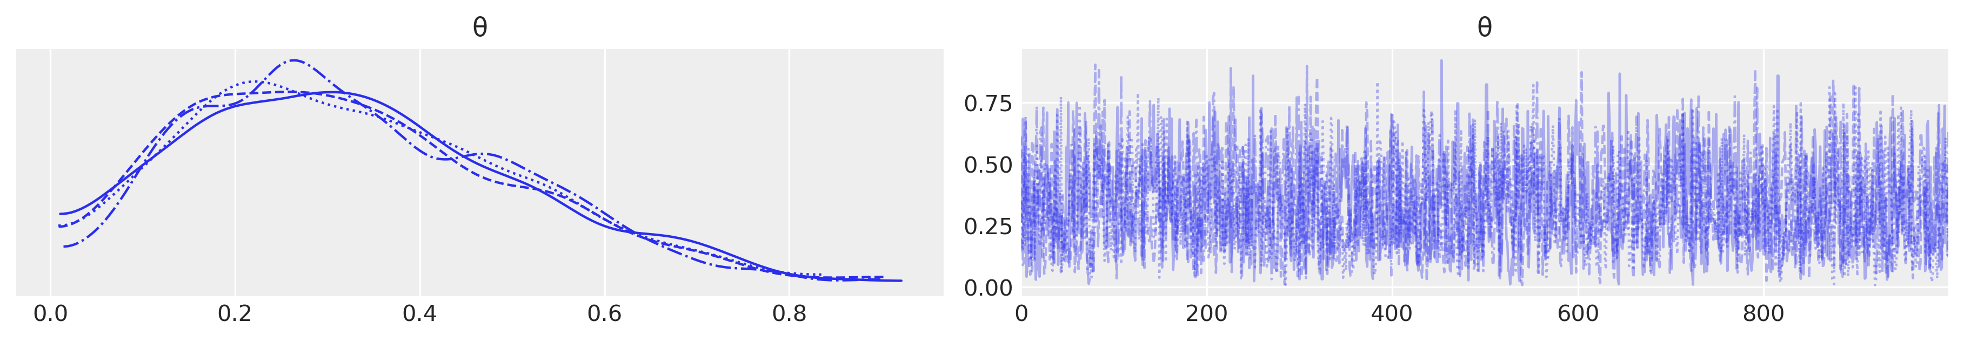
Sampling the posterior for fake data
Sample the posterior distribution of $θ$
idata = pm.sample(1000, model=our_first _model, random_seed=4591)
Plot the samples
az.plot_trace(idata)

Slide 39

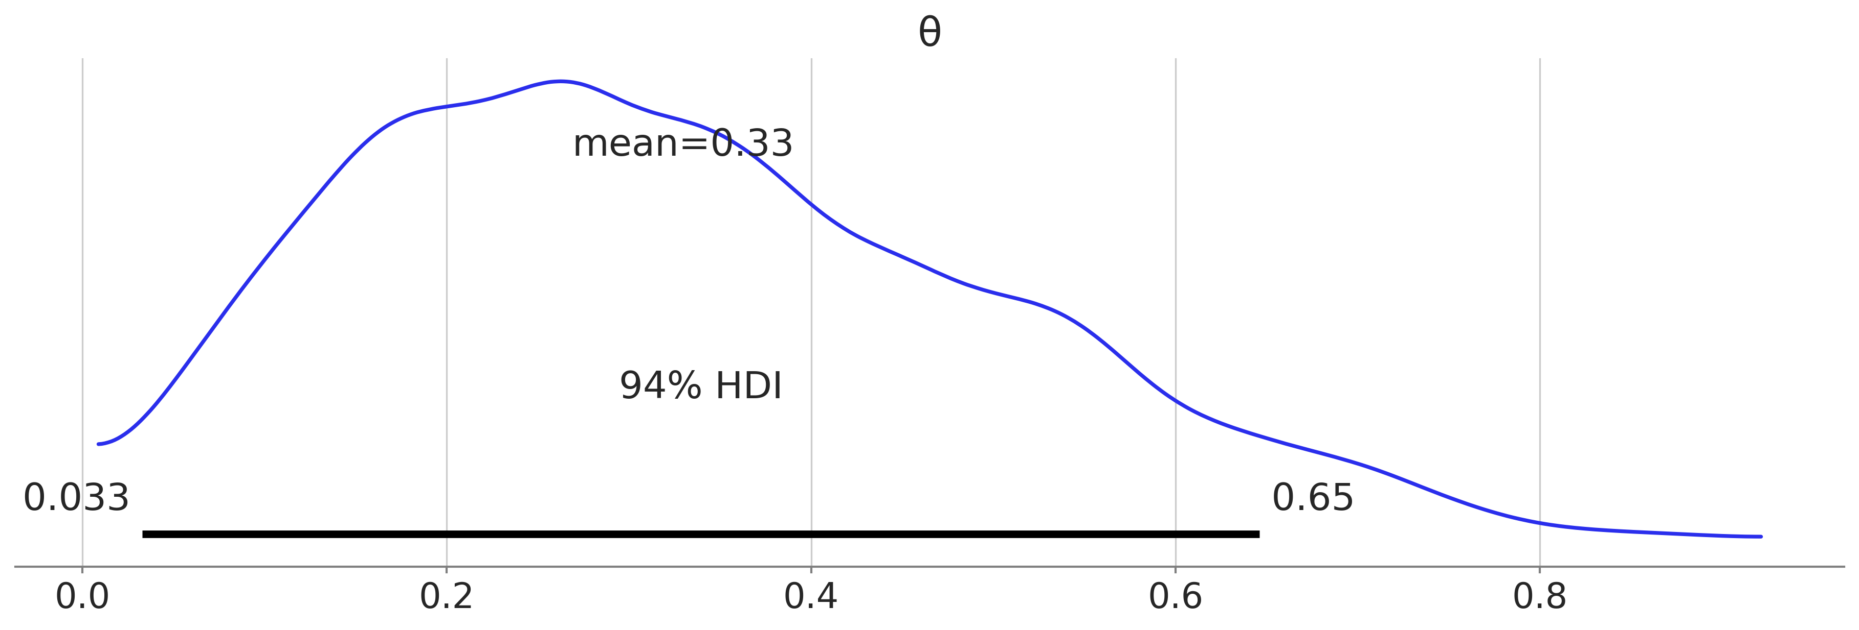
Examining the posterior distribution
az.summary(idata, kind="stats").round(2)
az.plot_posterior(idata, figsize=(12, 4))

Slide 40
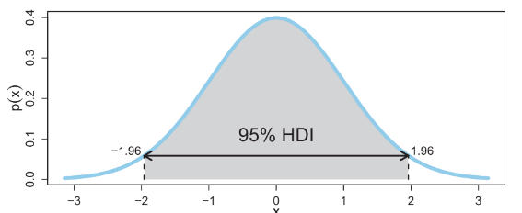
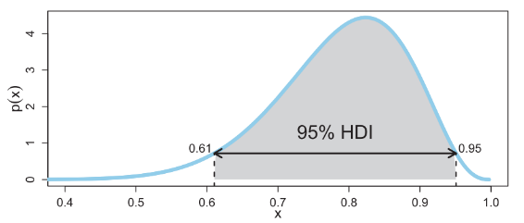
High density interval
An interval of largest values that contains 95% of the probability

Slide 41
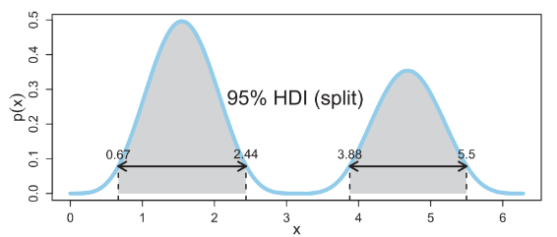
High density interval
An interval of largest values that contains 95% of the probability

Slide 42
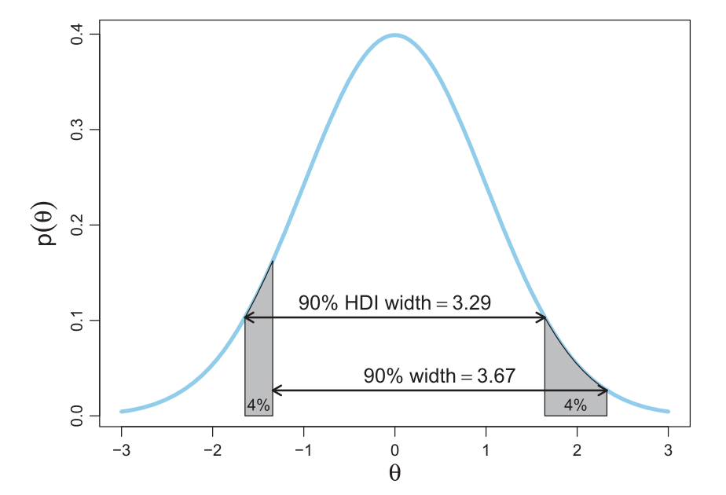
Logic of calculating HDI of a function
Unimodal
Univariate
HDI is the shortest interval

Slide 43
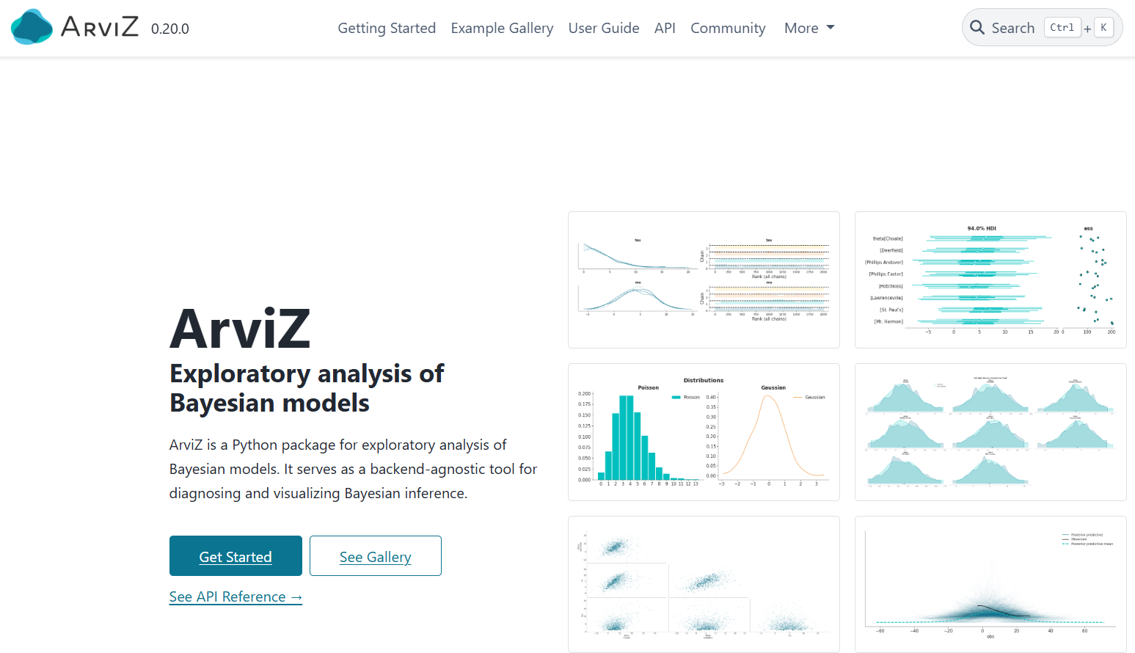
Arviz: Analyzing Bayesian data
https://python.arviz.org/en/stable/

Slide 44
3F Testing fairness

Slide 45
Is this a fair coin?
0.5 falls inside the HDI

Slide 46
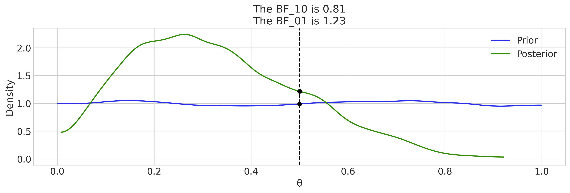
The Savage-Dickey density ratio
Ratio of prior and posterior density at a reference value
Measures evidence in data for or against that value
az.plot_bf(idata, var_name="θ", prior=np.random.uniform(0, 1, 10000), ref_val=0.5

Slide 47
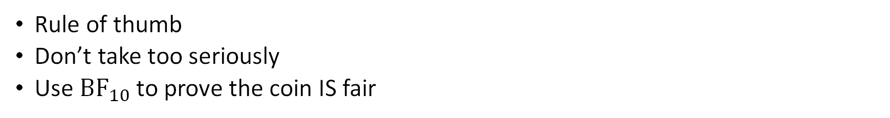
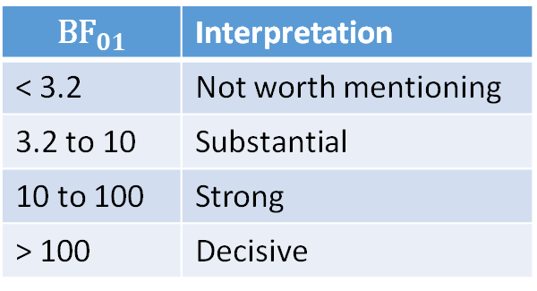
Interpreting the Savage-Dickey
Rule of thumb
Don’t take too seriously
Use ${\text{BF}}_{10}$ to prove the coin IS fair
$${\text{BF}}_{01}$$ | Interpretation
< 3.2 | Not worth mentioning
3.2 to 10 | Substantial
10 to 100 | Strong
> 100 | Decisive

Slide 48
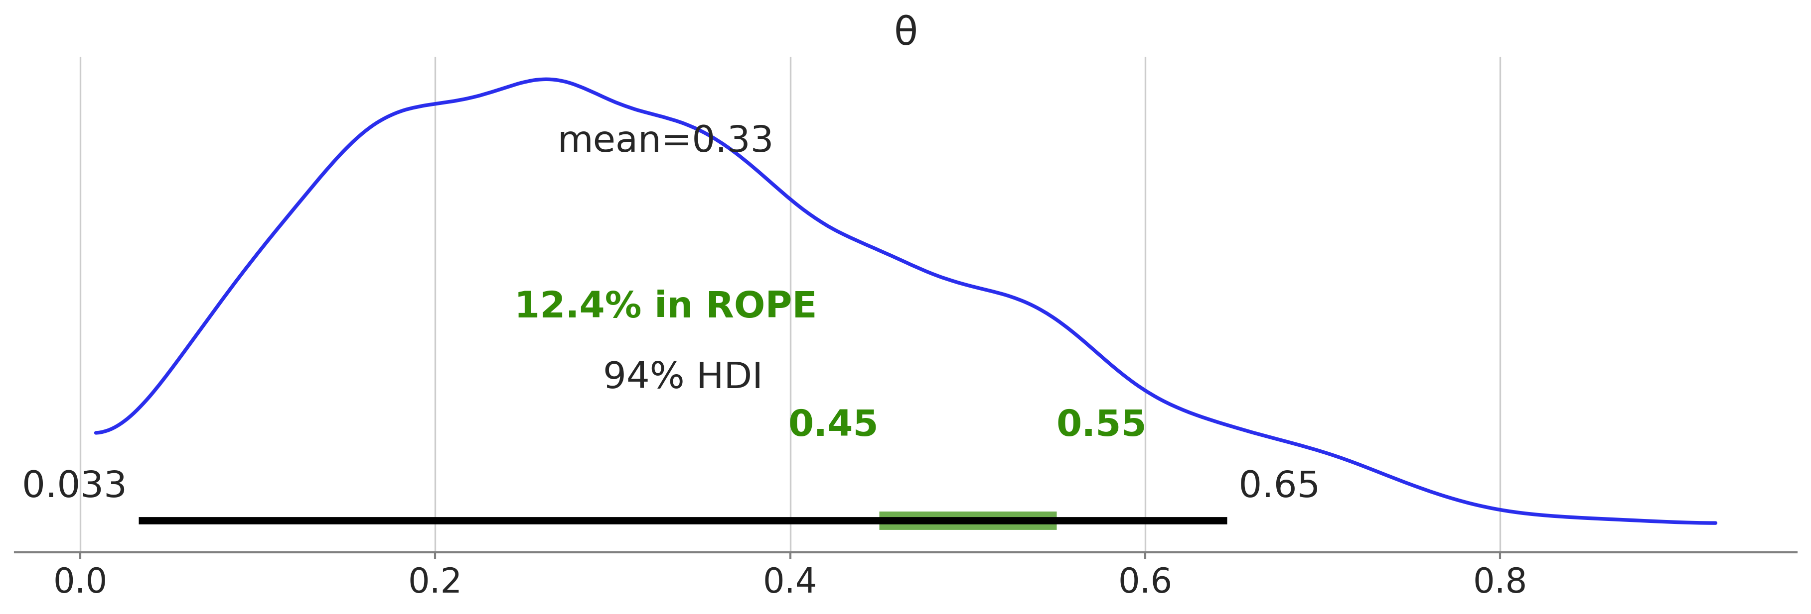
Region of Practical Equivalence (ROPE)
Region of near-fairness
Specified arbitrarily

Slide 49
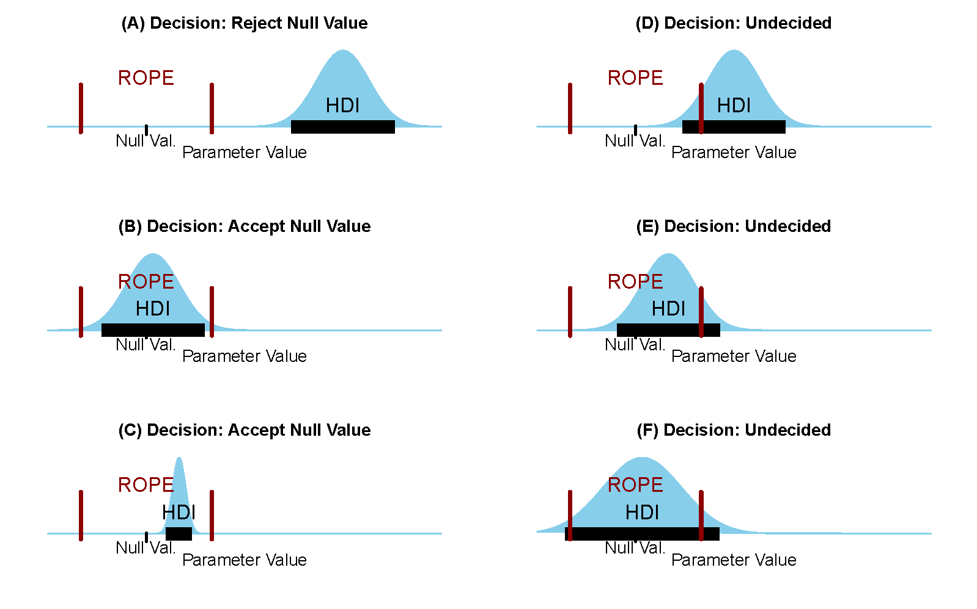
The ROPE and the HDI

